Slide 1

Deepfake Image Detection in Social Media Content
A Machine Learning Approach using CNN and Streamlit
Presented by :
Harsh Varkhedkar C-18
Shrutik Vankundre C-19
Aishwarya Waje C-20
Ishwaree Patil C-21

Slide 2
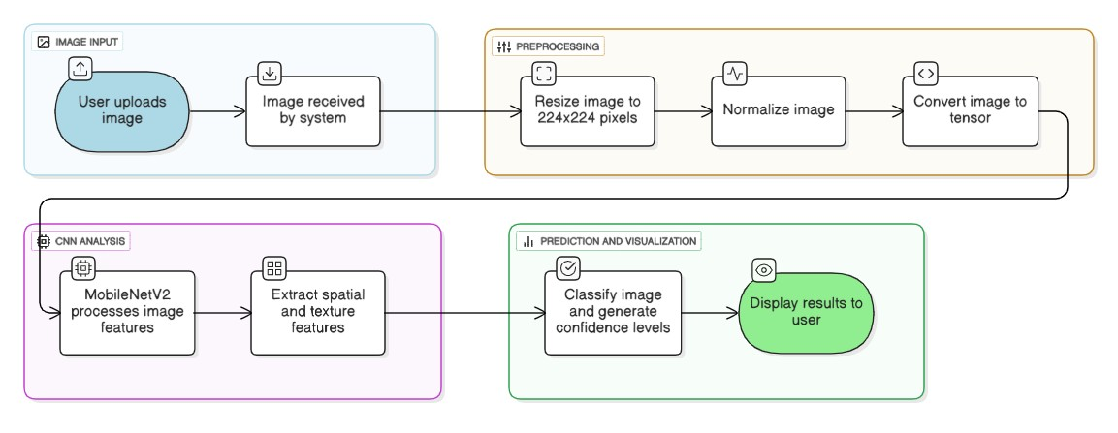
System Architecture
Our detection pipeline leverages MobileNetV2 transfer learning, a pre-trained convolutional neural network optimized for efficient image classification, adapted specifically for deepfake detection tasks.

Slide 3
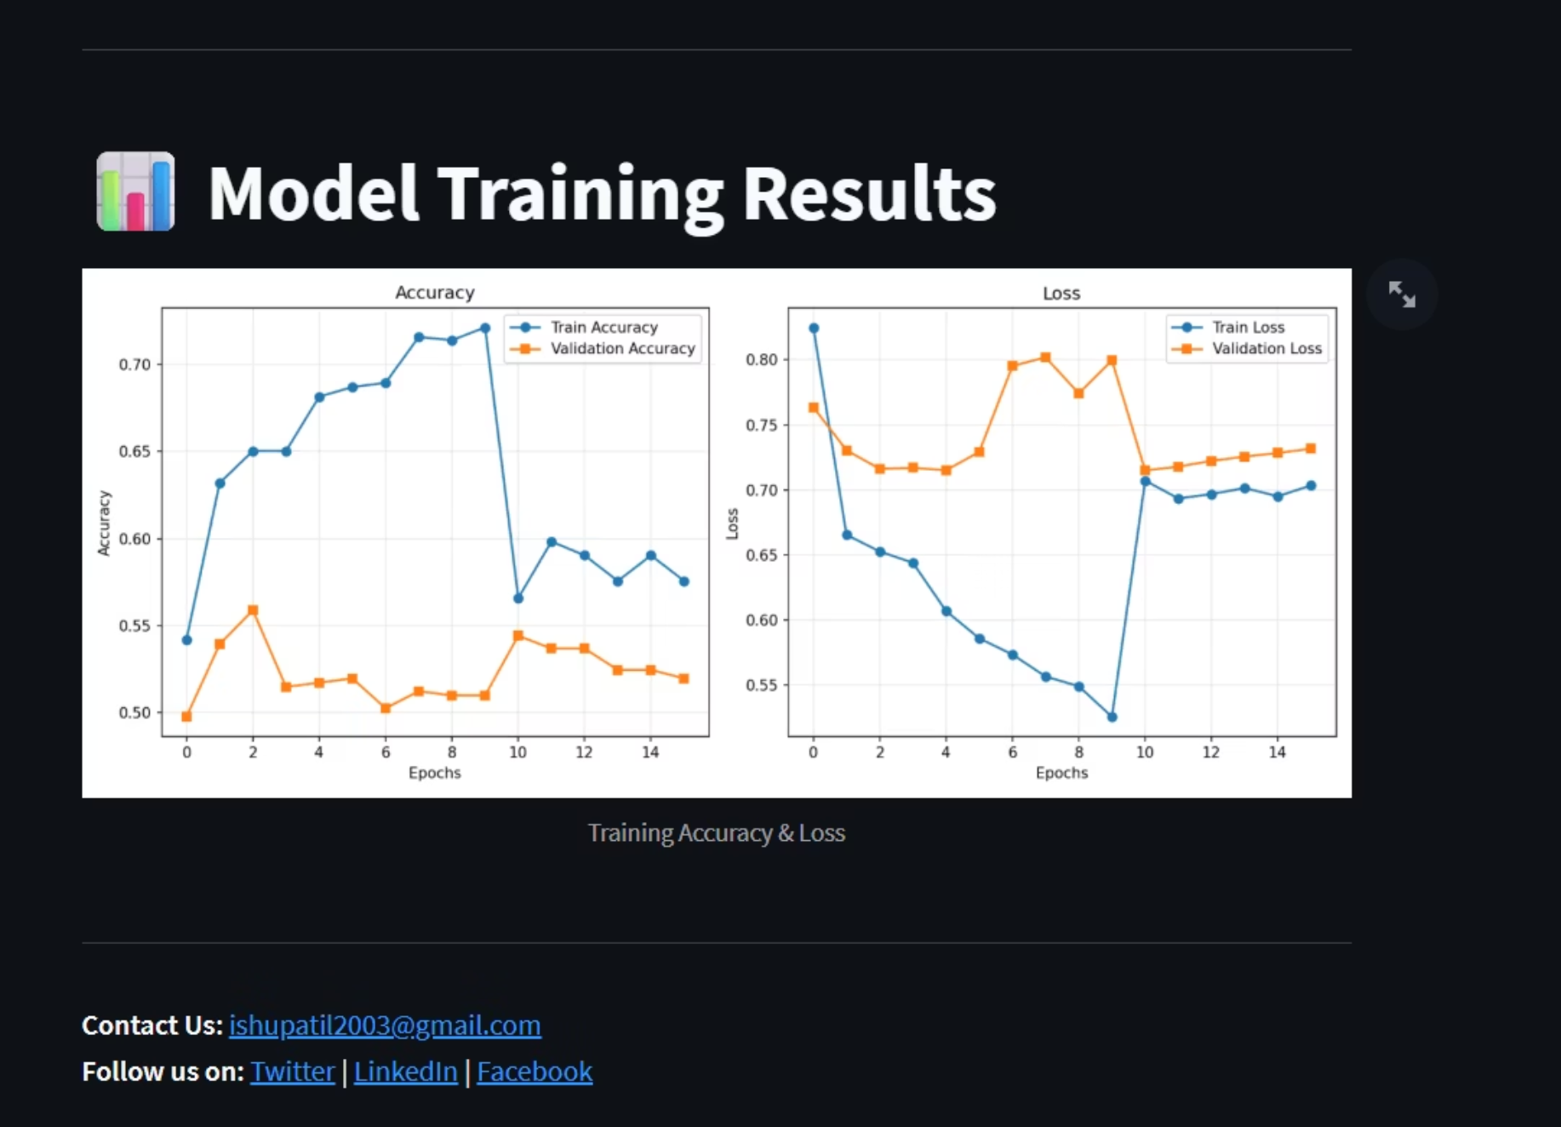
Model Training & Dataset
Training Approach
We utilized a carefully curated dataset containing both authentic facial images and AI-generated deepfakes to train our detection model.
Technology Stack
TensorFlow & Keras: Deep learning frameworks
OpenCV: Image processing and manipulation
NumPy: Numerical computations
MobileNetV2: Pre-trained CNN architecture
Preprocessing Steps
Image resizing to standard dimensions
Pixel normalization (0-1 scale)
Data augmentation for robustness
The training curves demonstrate the model's learning progression, with accuracy improving and loss decreasing over successive epochs. The validation metrics help ensure the model generalizes well to unseen data.

Slide 4

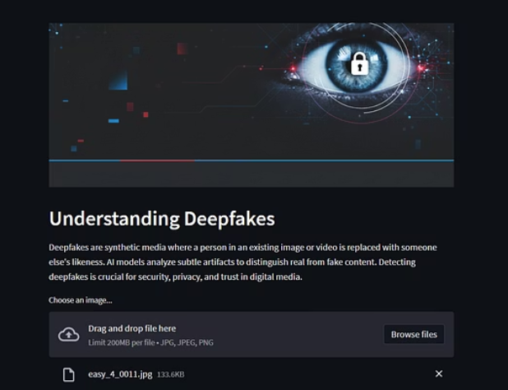
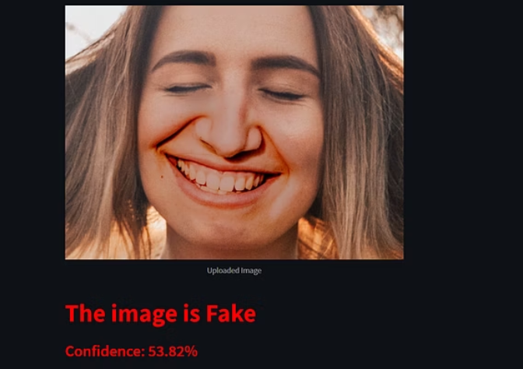
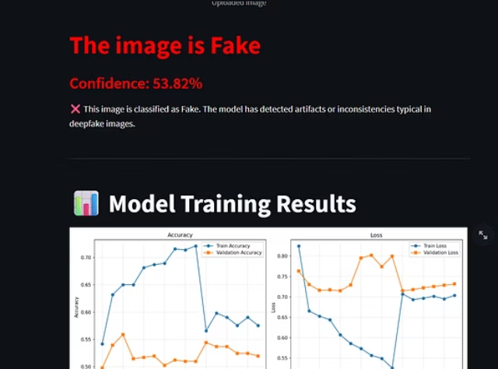
Streamlit Application Interface
01
02
03
Upload Image
Model Processing
Prediction Display
User selects and uploads an image file through the intuitive web interface
The CNN model analyzes the image for deepfake artifacts and anomalies
Results shown with classification (Real/Fake) and confidence percentage
Example Output: "The image is Fake – Confidence: 53.82%"
The confidence score indicates the model's certainty in its prediction, helping users understand the reliability of the detection.

Slide 5




Detection Capabilities
What the Model Detects
Lighting Inconsistencies
Facial Artifacts
Texture Anomalies
Edge Blending
Subtle distortions around eyes, teeth, and facial boundaries
Overly smooth or inconsistent skin textures typical of AI generation
Imperfect blending at boundaries where faces meet backgrounds
Unnatural shadows and lighting artifacts that reveal synthetic generation

Slide 6
Results & Performance Analysis
~70%
65%
53-85%
Training Accuracy
Validation Accuracy
Confidence Range
Model achieved solid performance on training dataset
Moderate generalization to unseen images
Typical prediction confidence scores
Key Insights
Strengths
Challenges
Effective detection of common deepfake artifacts
Performance trade-off between accuracy and generalization
Fast inference time suitable for real-time applications
Sophisticated deepfakes remain challenging to detect
User-friendly interface for accessibility
Requires continuous updates as generation techniques evolve
Identifies subtle inconsistencies invisible to humans
Limited by training dataset diversity

Slide 7




Future Enhancements
Video Detection
Extend capabilities to analyze deepfake videos frame-by-frame, addressing the growing challenge of video manipulation
Larger Datasets
Train on more diverse and extensive datasets to improve accuracy and handle various deepfake generation methods
GAN-Based Training
Implement adversarial training techniques to create a more robust model that adapts to evolving generation tactics
Explainable AI
Add visualization tools that highlight specific image regions triggering fake classification for better transparency

Slide 8

Conclusion
Key Takeaways
Our AI-powered deepfake detection system demonstrates the potential of machine learning to combat digital manipulation. By leveraging CNN architecture and transfer learning, we've created an accessible tool that helps identify synthetic content in social media.
While challenges remain, this work represents an important step toward preserving trust in digital media and protecting individuals from malicious use of AI-generated content.
The Path Forward
As deepfake technology continues to evolve, so must our detection methods. Ongoing research, larger datasets, and advanced architectures will be crucial in staying ahead of increasingly sophisticated synthetic media.
Thank You
For questions or collaboration opportunities:

